Slide 1
Central Tendency
Definition:
It is the property of concentration of the values around a central value in a data.
Measures of Central Tendency (Averages)
Mean
Median
Mode

Slide 2
Numerical summary
Numerical summary majors are
Measures of Central Tendency(Averages)
Mean
Median
Mode

Slide 3
Mean
What is Mean? How to calculate Mean?
Arithmetic mean is the most commonly used average or measure of the central tendency.
Definition- “Arithmetic mean is sum of observations divided by the total number of observations”.
Denoted by X

Slide 4
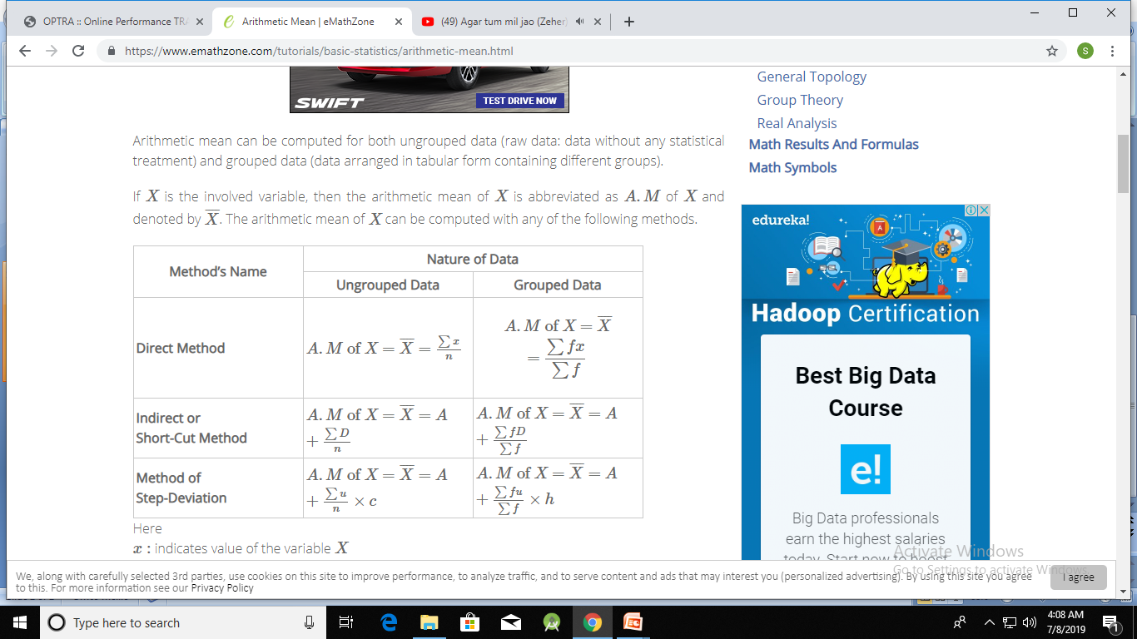
Mean
Calculation:

Slide 5
Mean
Calculate mean for the following data of Height (inches) of a set of students by direct method.
Height(inches):61,62,63,61,63,64,64,60,65,63,64,65,66,64
Solution
The data is ungrouped data.
Direct Method X̅ = Ʃx /n = 885/14 = 63.2inches.

Slide 6
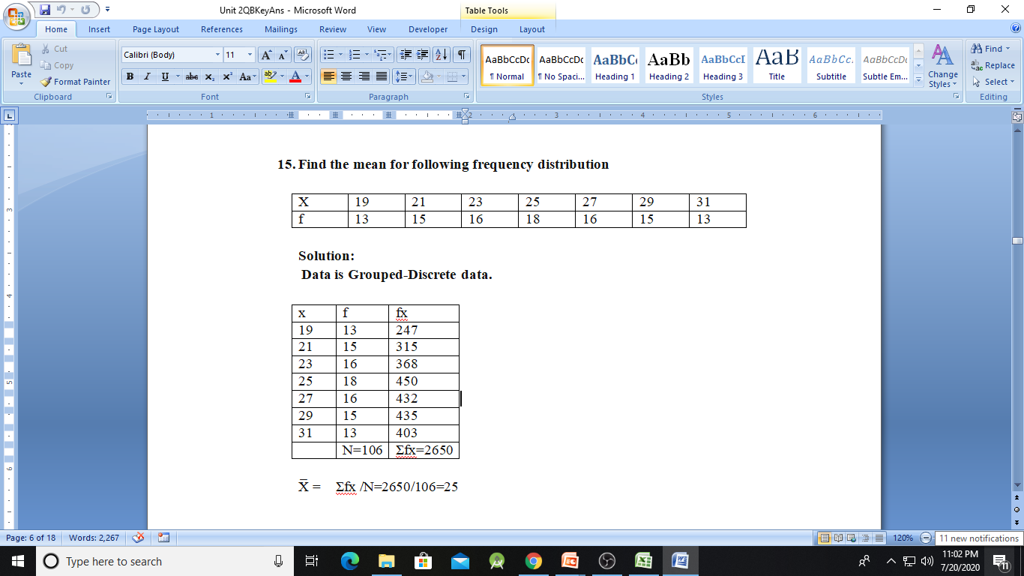
Mean

Slide 7
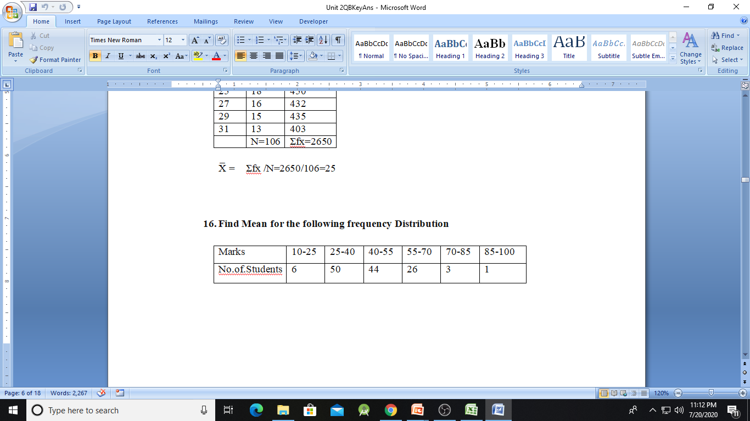
Mean
Find Mean for the following frequency Distribution

Slide 8
Mean
Solution:
The given data is Grouped-Continuous frequency distribution with exclusive class intervals.
X=Lower Limit + Upper Limit /2

Slide 9
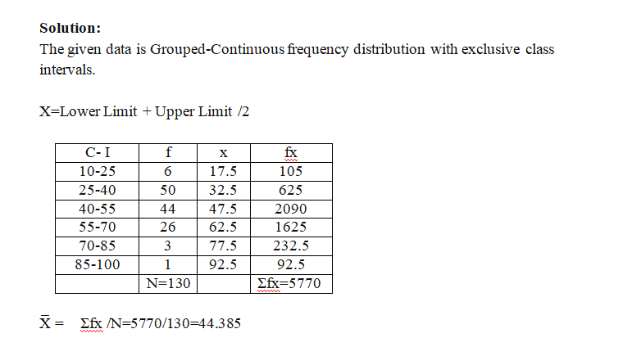
Mean

Slide 10
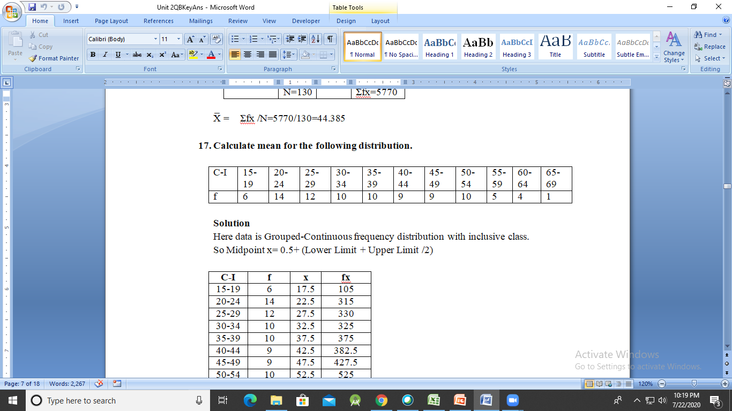
Mean

Slide 11
Mean
Solution
Here data is Grouped-Continuous frequency distribution with inclusive class.
So Midpoint x= 0.5+ (Lower Limit + Upper Limit /2)

Slide 12
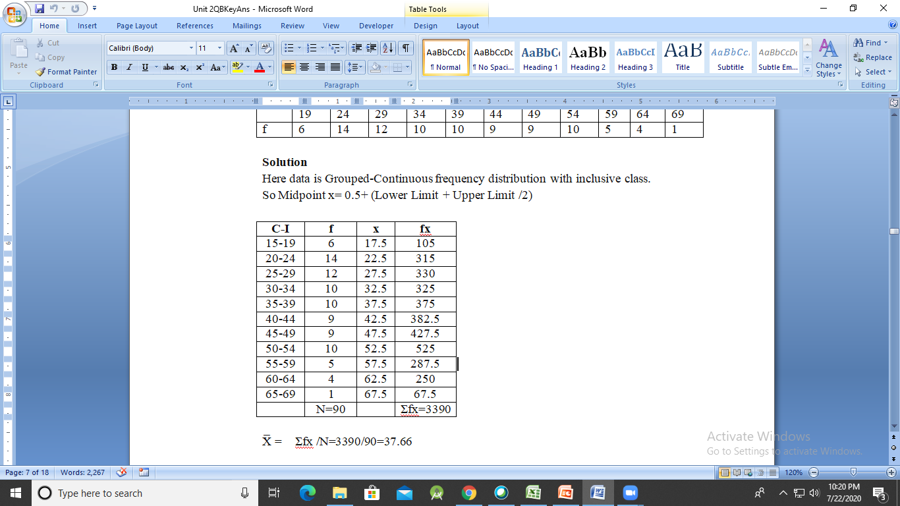
Mean

Slide 13
Median
What is Median? How to calculate Median?
It is the middle most value of a data when they are arranged in an order
It is denoted by M.
Calculation
Ungrouped Data
Arrange the given data in an order (ascending).
Find (n+1/2) where n denotes the no. of observations.
Median=M=values of [(n+1)/2]^{th} observation.

Slide 14
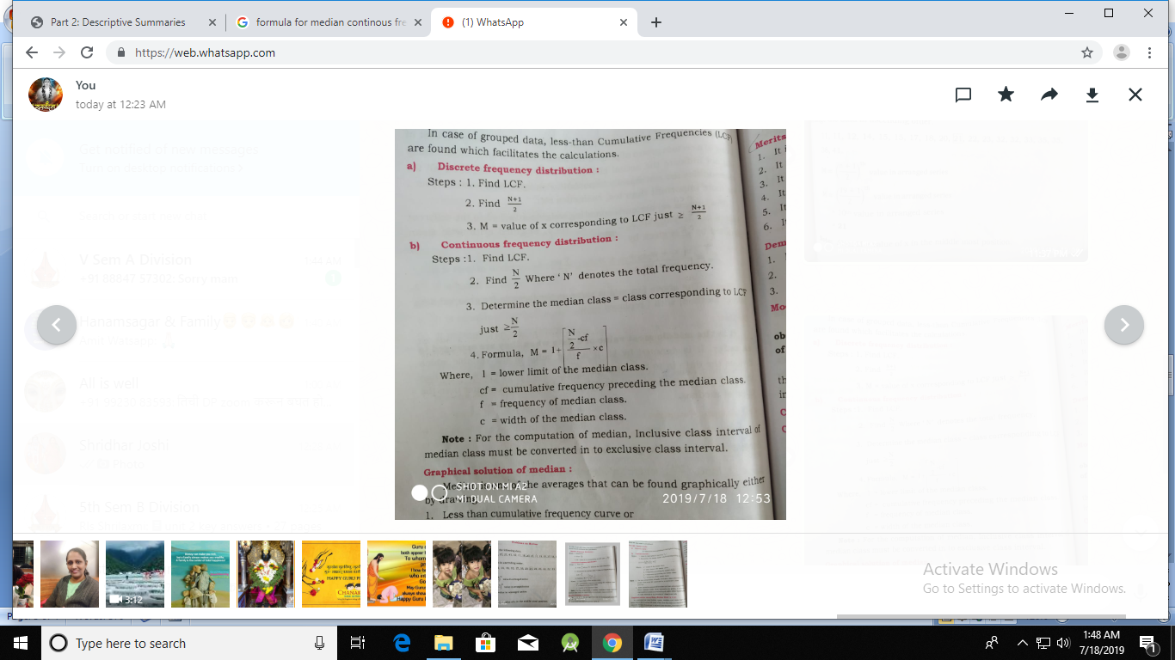
Median
Grouped Data

Slide 15
Median
Find the median for the following data.
17,32,35,33,15,21,41,32,11,18,20,22,11,15,35,23,38,12,14
Solution
Data is Ungrouped Data
Arrange the data in ascending order
11,11,12,14,15,15,17,18,20,21,22,23,32,32,33,35,35,38,41
M = (n+1/2)^{th} value in arranged series
M= (19+1/2)^{th} value in arranged series
M= 10th value in arranged series
M=21

Slide 16
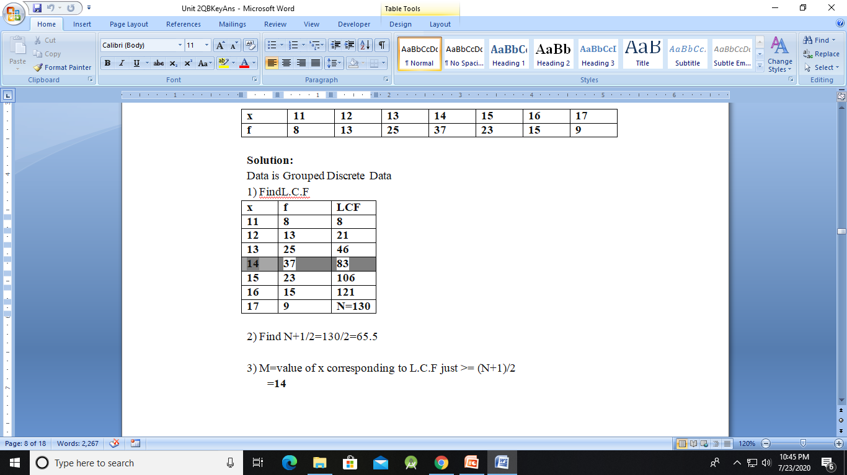
Median
Find the median for the following data.

Slide 17
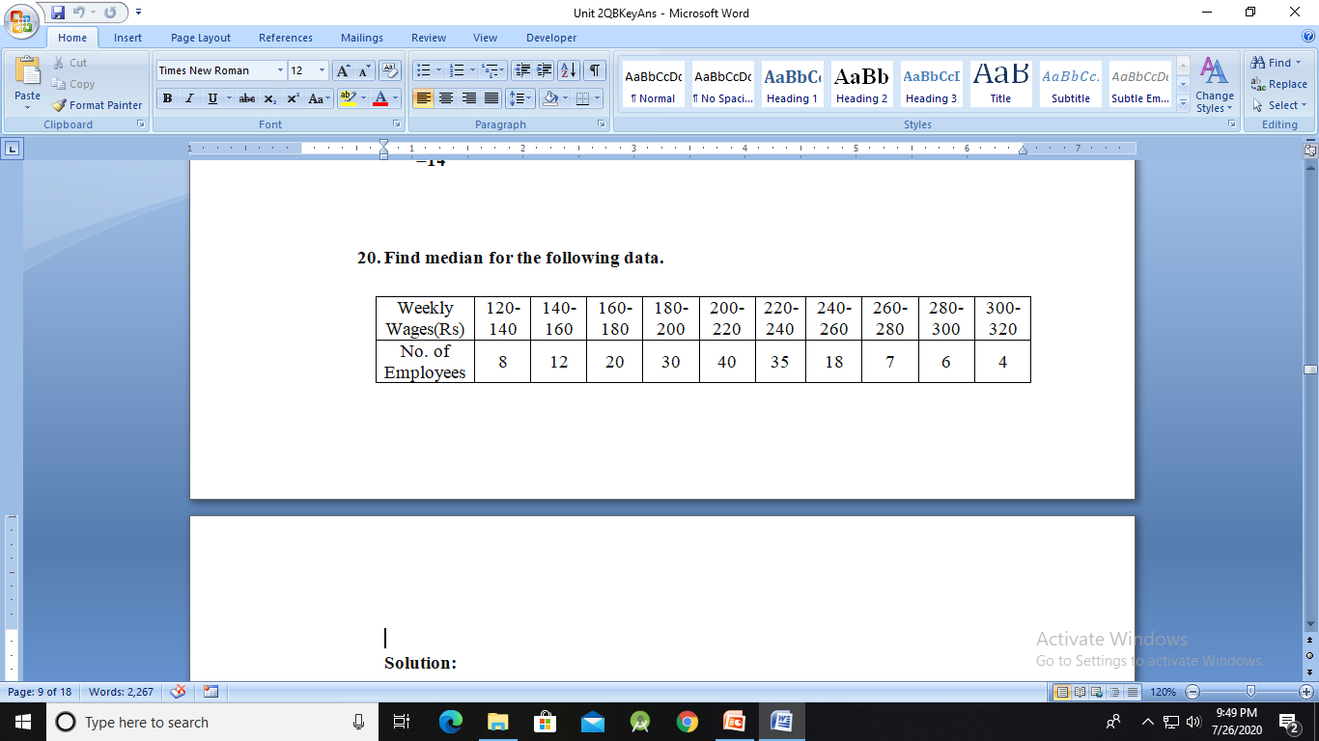
Median

Slide 18
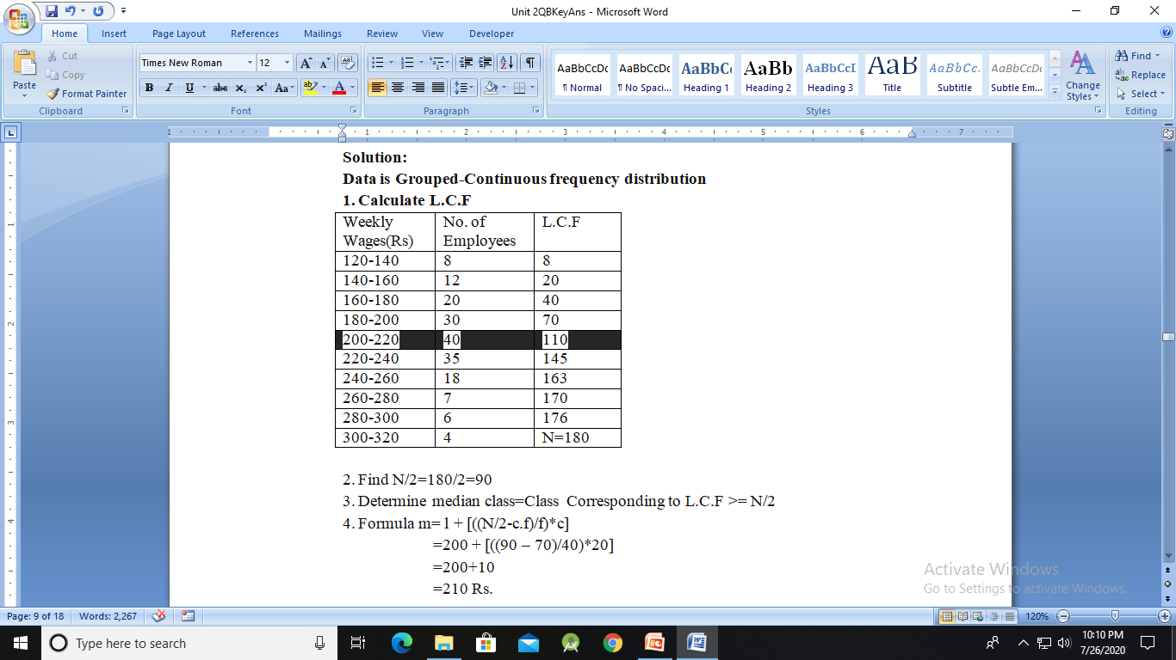
Median

Slide 19
Mode
What is Mode? How to calculate Mode?
It is the value which occurs most frequently in set of observations and around which there is maximum concentration of values.
It is denoted by ‘Z’
Calculation Ungrouped Data
It is found by inspection.

Slide 20
Mode
Find the mode for the following data regarding wages (Rs.) of 10 persons.
100,120,100,120,130,120,120,130,120,100
Solution:
Ungrouped Data
In given data 120 appears maximum number of times
Thus, Z=120

Slide 21
Quartiles
Definition
A measure which divides the data into four equal parts is known as quartiles.
There are three quartiles which divide data into four equal parts. They are denoted by Q1, Q2, and Q3.

Slide 22
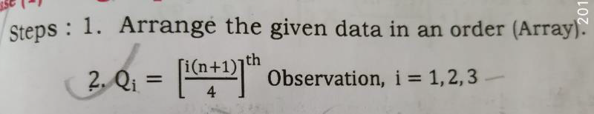
Quartiles

Slide 23
Quartiles
Calculate Lower Quartile and upper Quartile for following Data
22,26,14,30,18,11,35,41,12,32

Slide 24
Quartiles
Solution:
Arrange the given data in ascending order.
11,12,14,18,22,26,30,32,35,41

Slide 25
Quartiles
Lower Quartile
Q₁ = ((n+1)/4)^{th} observation
= ((10+1)/4)^{th} observation
= (2.75)^{th} observation
= 2nd observation + 0.75(3rd observation – 2nd observation)
= 12 + 0.75(14-12)
= 13.5

Slide 26
Quartiles
Upper Quartile
Q₃ = (3*(n+1)/4)^{th} observation
= (3*(10+1)/4)^{th} observation
= (8.25)^{th} observation
= 8th observation + 0.25(9th observation – 8th observation)
= 32 + 0.25(35-32)
= 32.75

Slide 27
Percentiles
Definition
A measure which divides the data 100 equal parts is known as Percentiles.
Calculate Percentiles for ungrouped data
P_{i} =[ (i/100)*n]^{th} observation
If i is not whole number then the answer is in the next postion
Example P_{i} = 2.1 =3rd observation.
If i is whole number then the answer is in the next postion
Example P_{i} = 4 = Average of 4th + 5th observation

Slide 28
Percentiles
Calculate Percentile P_{10,} P50 following data.
22,26,14,30,18,11,35,41,12,32

Slide 29
Percentiles
Solution:
Arrange the given data in ascending order.
11,12,14,18,22,26,30,32,35,41
P_{i} =[(i/100)*n]
P₁₀ =(10/100)*10
P₁₀ =1
P₁₀ is whole number
P₁₀ = (1st observation + 2nd observation)/2
P₁₀ = (12+11)/2
P₁₀ =23/2
P₁₀ =11.5

Slide 30
Percentiles
P₅₀ = (50/100) *10 Observation.
P₅₀ =5
P₁₀ is whole number
P₅₀ = (5th observation + 6th observation)/2
P₅₀ = (22+26)/2
P₅₀ =48/2
P₅₀ =24

Slide 31
Range
Definition
It is difference between the highest value and the least value in a given data. It is denoted by R
Calculation of Range
R = H –L
Where H=Highest value L=Least value

Slide 32
Inter Quartile Range
Definition
Inter Quartile Range is difference between Upper Quartile and Lower Quartile.
Calculation of Inter Quartile Range
Inter Quartile Range=Q3 - Q1

Slide 33
Standard Deviation
Definition
The standard deviation is a statistic that measures the dispersion of a dataset relative to its mean and is calculated as the square root of the variance.

Slide 34
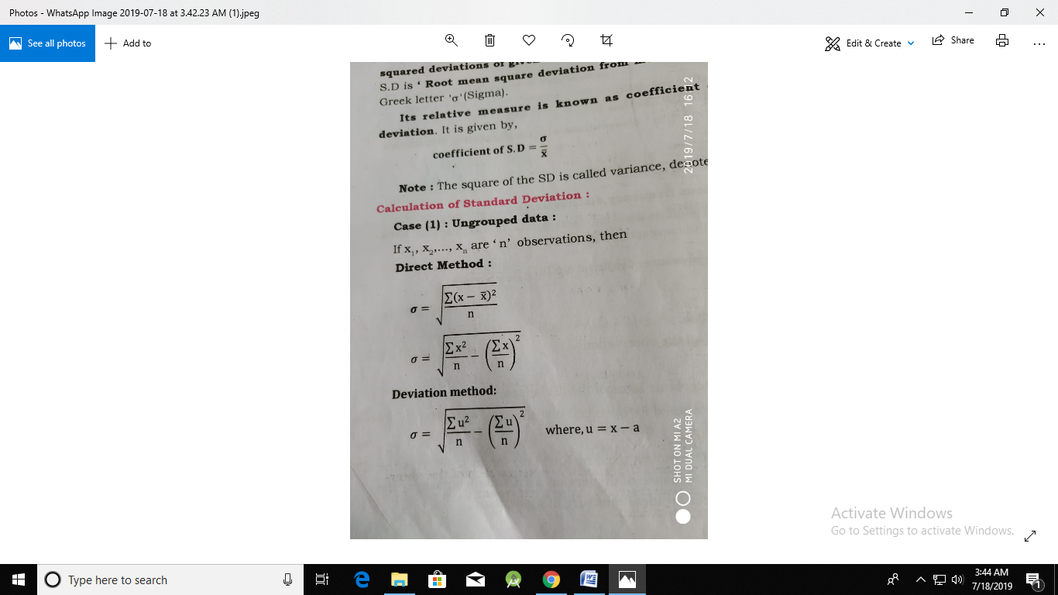
Standard Deviation

Slide 35
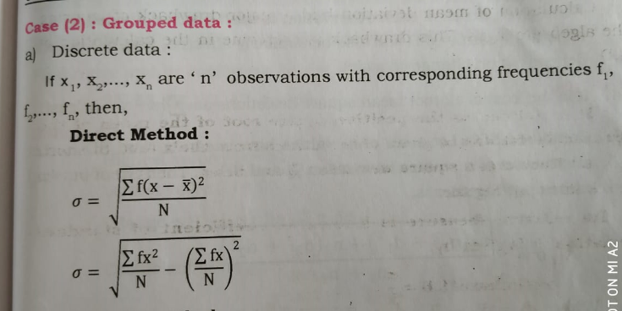
Standard Deviation

Slide 36
Standard Deviation
Find the standard deviation and variance for the following data
8,915,23,5,11,19,8,10,12

Slide 37
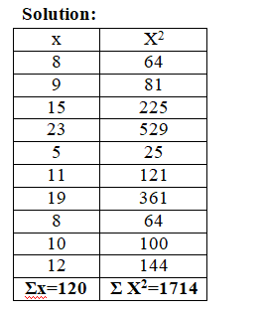
Standard Deviation

Slide 38
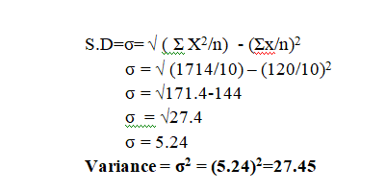
Standard Deviation

Slide 39
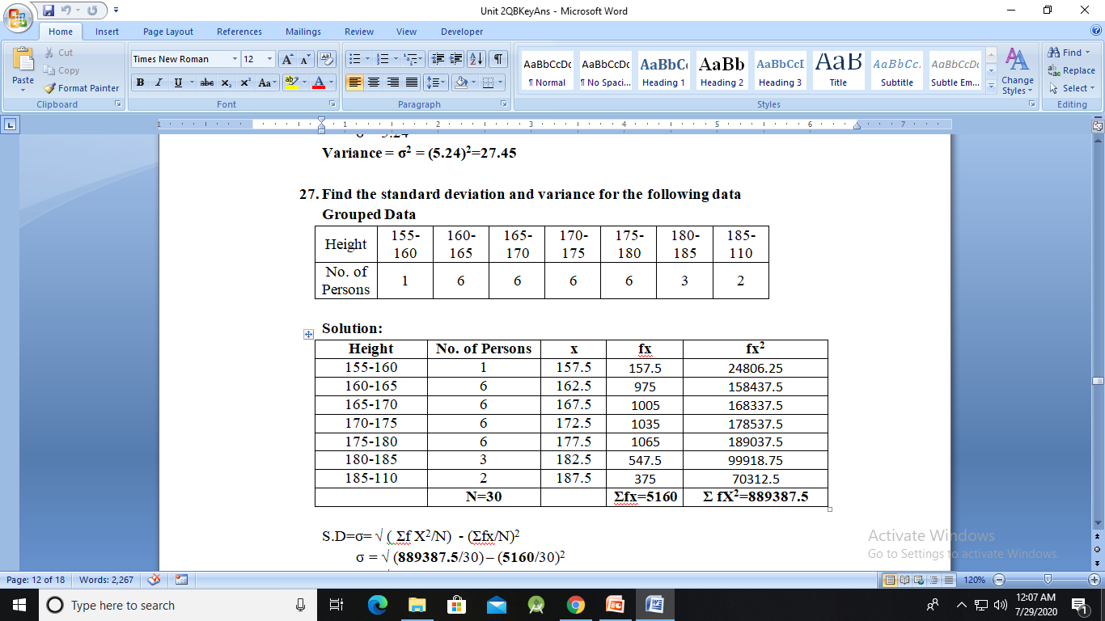
Standard Deviation

Slide 40

Standard Deviation

Slide 41
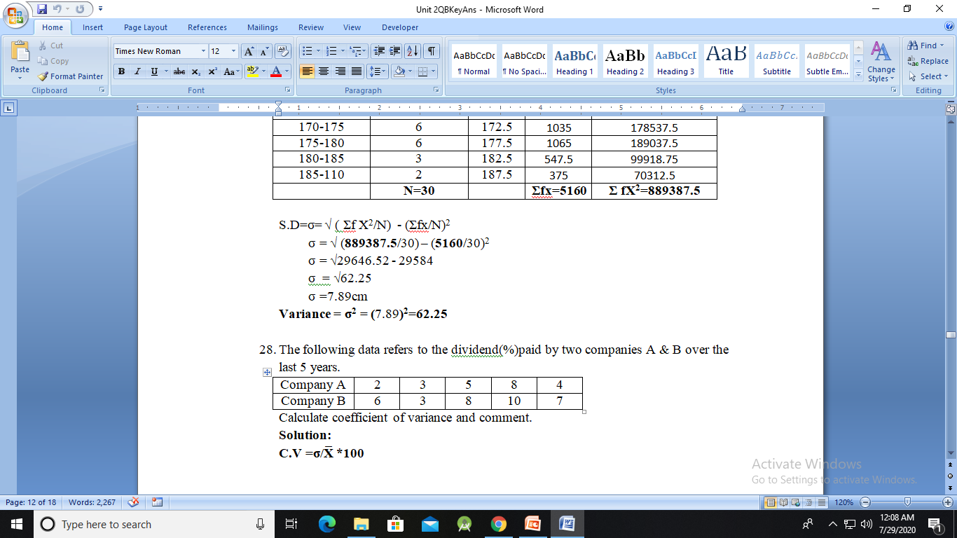
Standard Deviation

Slide 42
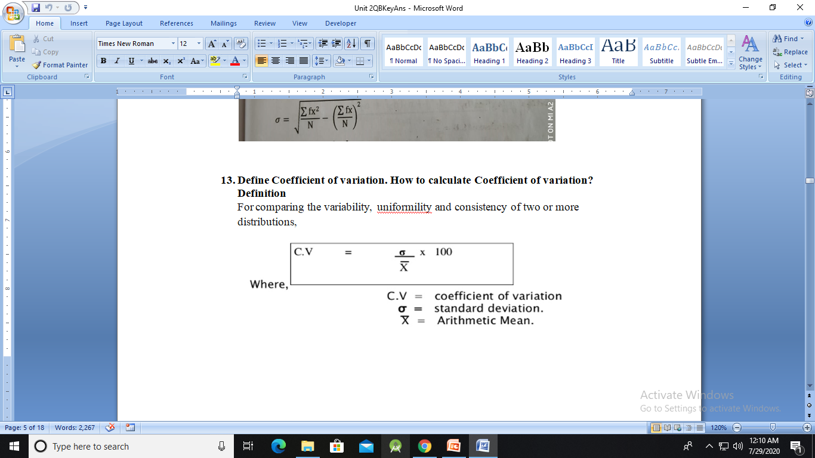
Coefficient of variation

Slide 43
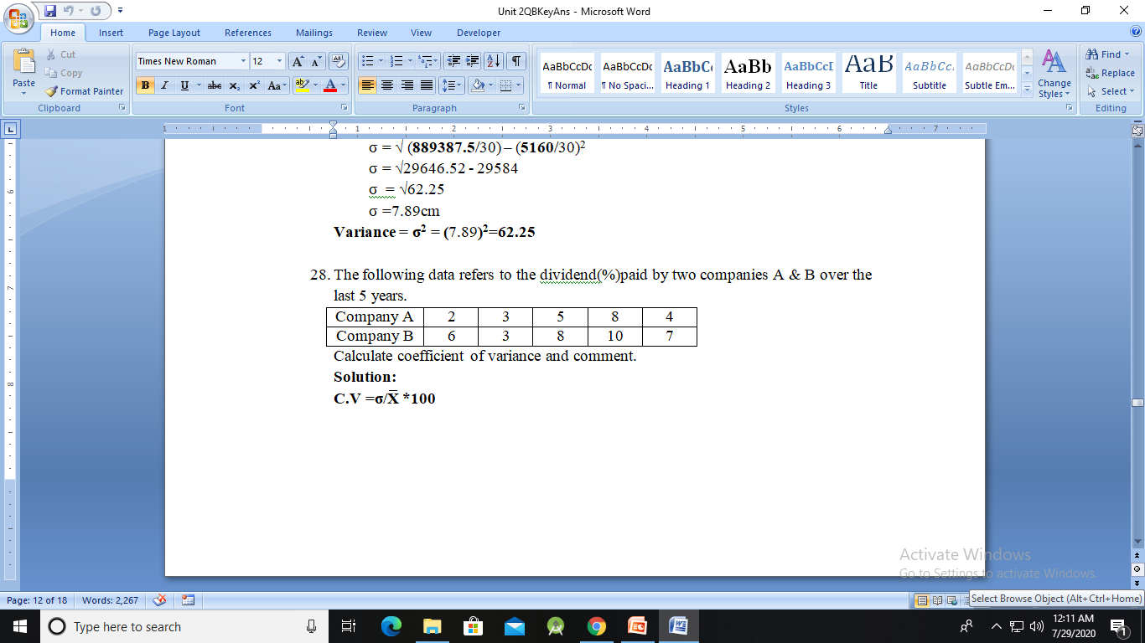
Coefficient of variation

Slide 44
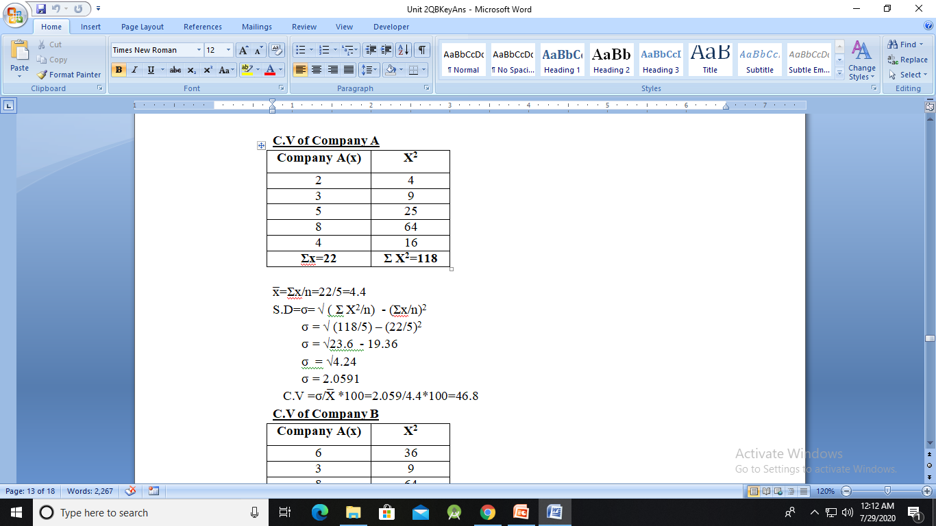
Coefficient of variation

Slide 45
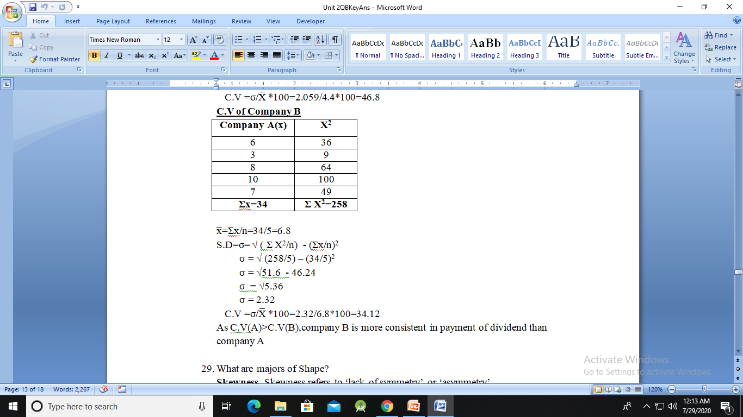
Coefficient of variation

Slide 46
Coefficient of variation
As C.V(A)>C.V(B),company B is more consistent in payment of dividend than company A

Slide 47
Majors of Shape
Skewness- Skewness refers to ‘lack of symmetry’ or ‘asymmetry’
Kurtosis- Kurtosis means peakedness in the region of mode of a frequency curve.

Slide 48
Skewness
Skewness.
Skewness- Skewness refers to ‘lack of symmetry’ or ‘asymmetry’
Skewness is refers to the extent the data is asymmetrical from the normal distribution.
Types of Skewness
1) Positively skewed distribution
2) Negatively skewed distribution

Slide 49
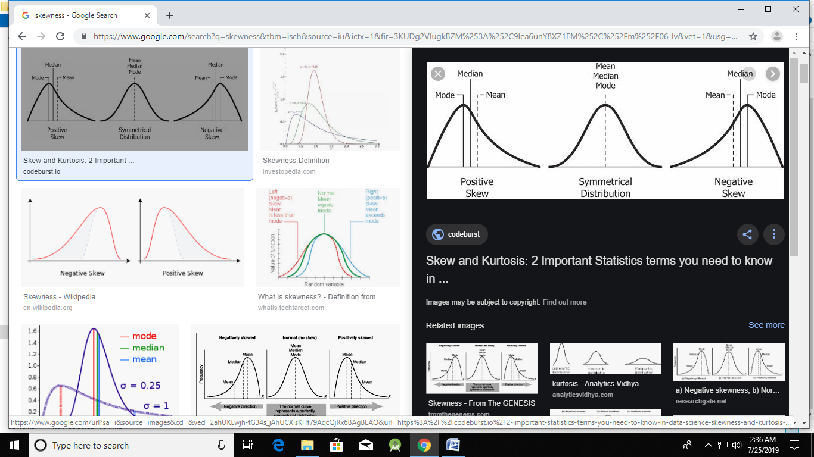
Skewness
Symmetric Distribution
Mean =Median = Mode
No Skewness

Slide 50
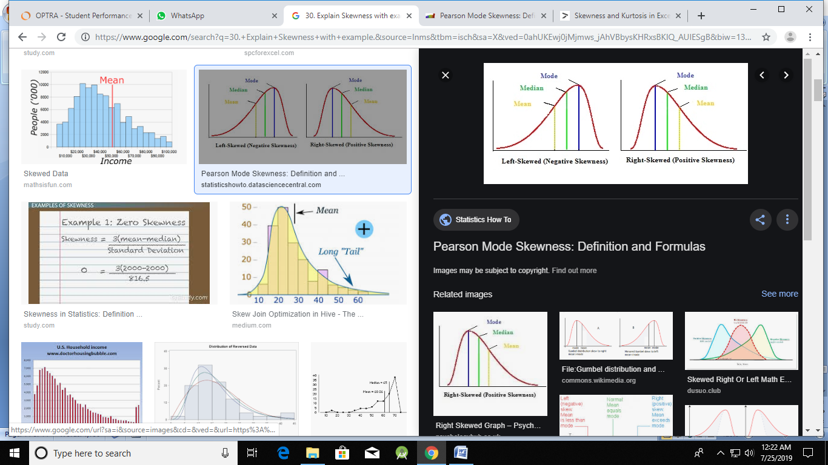
Skewness
Positively skewed distribution
Mean>Median>Mode

Slide 51

Skewness
Negatively skewed distribution
Mean<Median<Mode

Slide 52
Skewness
If the skewness is between -0.5 and 0.5, the data are fairly symmetrical.
If the skewness is between -1 and -0.5(negatively skewed) or between 0.5 and 1(positively skewed), the data are moderately skewed.
If the skewness is less than -1(negatively skewed) or greater than 1(positively skewed), the data are highly skewed.

Slide 53
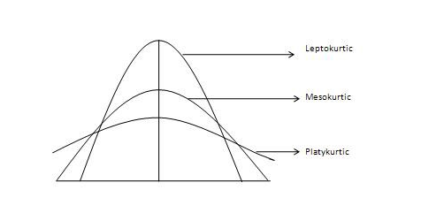
Kurtosis
The study of peakness of the frequency curve is called Kurtosis. It is used to describe the extreme values in one versus the other tail. It is actually the measure of outliers present in the distribution.

Slide 54
Kurtosis
In the above diagram, curve which is neither flat nor peaked is known as normal curve (mesokurtic)
In the above diagram, curve which is peaked more than normal curve is known leptokurtic.
In the above diagram, curve which is less peaked than normal curve known as Playkurtic

Slide 55
Histogram
A Histogram is a set of adjacent rectangles, whose height and width are proportional to class frequency and width of the class respectively.
Characteristics of a Histogram
Histogram is used to represent categorization of Continuous data
There is no gap between the bars unlike Bar graph, to signify that the data is continuous
The width of the groups is equal.

Slide 56
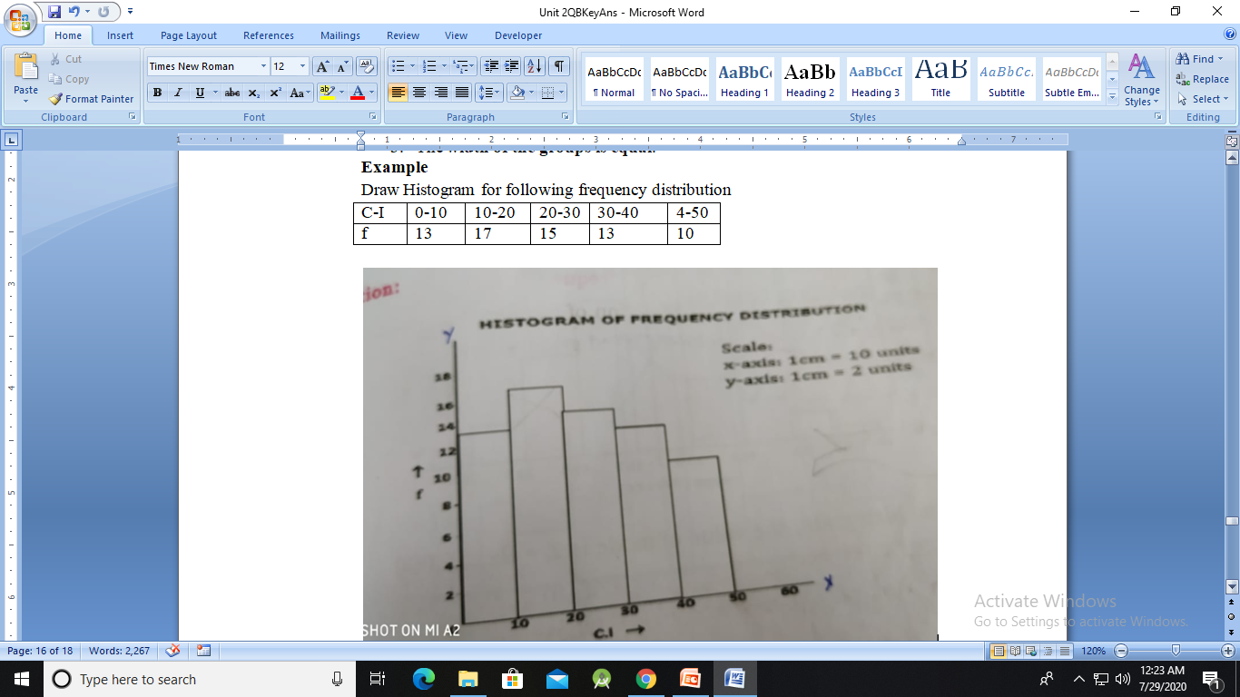
Histogram

Slide 57
Outliers
An outlier is a value or an entire observation (row) that lies well outside of the norm.
Some statisticians define an outlier as any value more than three standard deviations from the mean, but this is only a rule of thumb.
It is best to run the analyses two ways: with the outliers and without them.

Slide 58
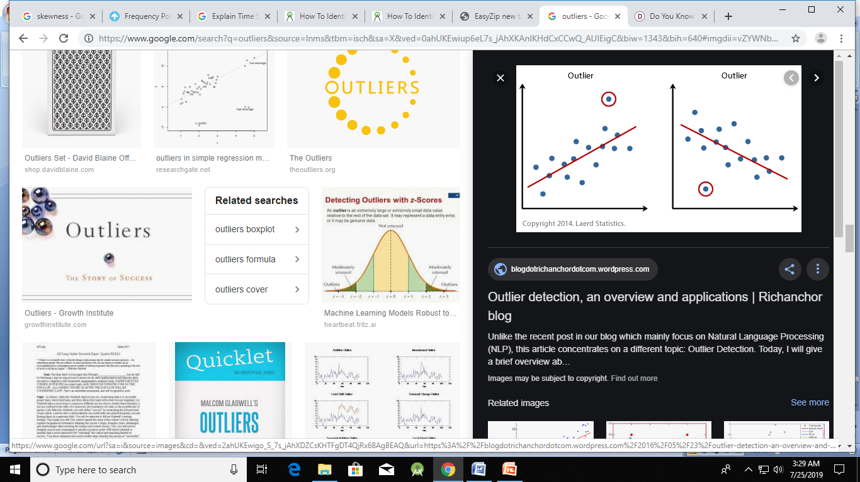
Outliers

